Slide 1


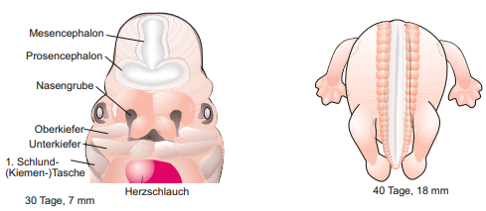

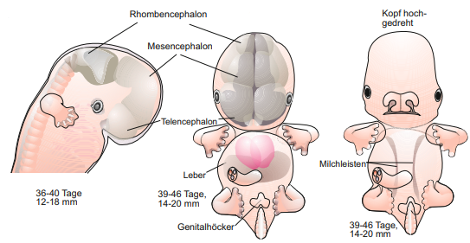


Biological background
2. Embryonic development
Entwicklungs- und Reproduktionsbiologie
Müller 2018
Our dataset targets week 4 to 9 of embryonic development
Notes:
It’s a quite interesting issue how a complex multicellular organism develops from a single cell. Our dataset targets week 4 to 9. Especially the brain develops
At week 4: the neural tube closes and the heart starts to beat and first structures like arm buds develop.
The brain of the fetus grows during the next weeks and the Prosencephalon develops to the Diencephalon and Telencephalon. Furthermore the morphology of the embryo changes.
Major parts of the brain are developed at week 9.
Many signals influence the development of the brain e.g. chemokines.

Slide 2
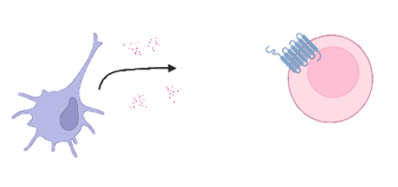
Biological background
3. Chemokines
Groupe of small similar proteins
chemoattractors
Bind to G-Protein coupled receptors (GPCR) → induce signaling cascade
Notes:
But what are chemokines ?
Small groupe of proteins with similar structure.
Chemoattractors: -> cells (dendritic cells) rerlease them, effector cells (leukocytes) move to the origin of release
->chemokines bind to GPCR and induce signaling cascade
They play an important role in embryonic development, which is unknown.

Slide 3
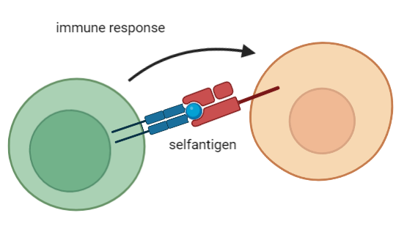
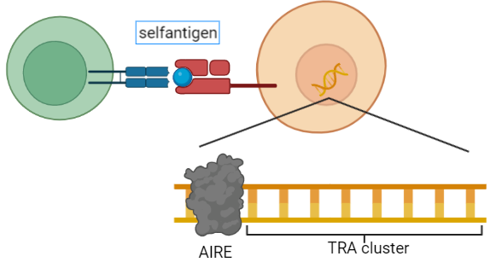
Biological background
4. Tissue restricted antigens (TRAs)
Genes for Self-antigens → essential for functional immune cells
Genes which are more than 5x than the median in less than 5 tissues expressed
Ordered in Autoimmune Regulator (AIRE) controlled cluster
Notes:
Another important issue are TRAs
Functional immune cells are necasssary to prevent infections
Shouldn’t react against selfantigens -> negative control in thymus
Medullary thymic epithelial cells (mTECs) present slef-antigens on their surface, reacting immune cell will be removed
Tissue restricted antigens (TRAs) code for selfantigens
Genes more than 5x the median in less than 5 diffrent tissues expressed
TRAs are ordered in cluster which are controlled by the transcriptionfactor Autoimmune Regulator (AIRE)

Slide 4
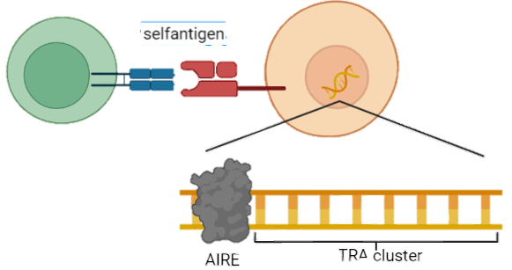
Biological background
4. Tissue restricted antigens (TRAs)
Genes for Self-antigens → essential for functional immune cells
Genes which are more than 5x than the median in less than 5 tissues expressed
Ordered in Autoimmune Regulator (AIRE) controlled cluster
Notes:
Another important issue are TRAs
Functional immune cells are necasssary to prevent infections
Shouldn’t react against selfantigens -> negative control in thymus
Medullary thymic epithelial cells (mTECs) present slef-antigens on their surface, reacting immune cell will be removed
Tissue restricted antigens (TRAs) code for selfantigens
Genes more than 5x the median in less than 5 diffrent tissues expressed
TRAs are ordered in cluster which are controlled by the transcriptionfactor Autoimmune Regulator (AIRE)

Slide 5
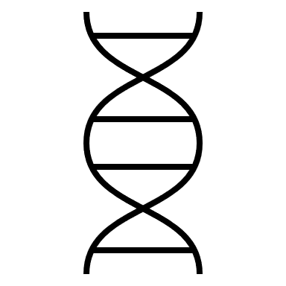

Dataset

Slide 6
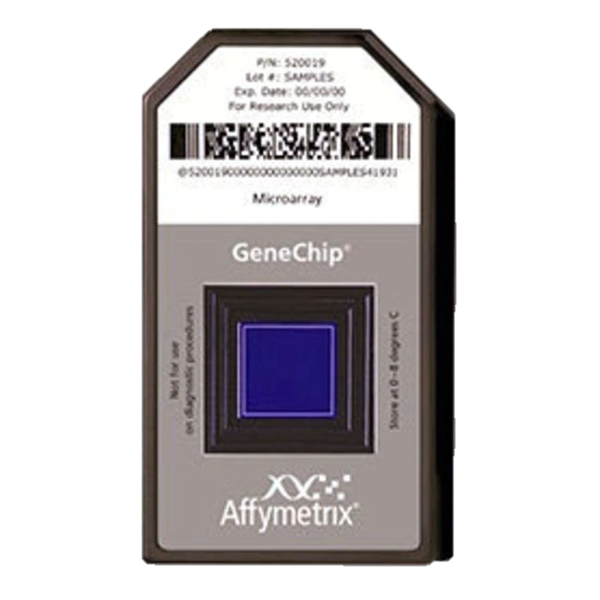
Quality control (QC)
Affymetrix Human Genome U133 Plus 2.0 Array
Expression analysis of over 47,000 transcripts and variants through comparison of 54 000 probe sets
detection sensitivity 1:100,000
Gen sequences of probe sets are selected from GenBank®, dbEST, and RefSeq
complementary oligonucleotide probes are synthesized in situ on the array
www.thermofisher.com/
Notes:
Before we start to investigate the quality of our acquisition, I am going to intoduce our microarray.
Our dataset was obtained by the affymetrix human genome U133 Plus 2.0 Array, which analysis the expression data of over 47,000 transcripts and variants and has a sensitivity of 1 transcriptome in a 1000 according to the technical sheet.
The relevent gen sequences were selected from GenBank, dbest and RefSeq and complementary oligonucleotide probes are synthesized in situ on the array

Slide 7
Quality control
1. Array surface images
No spatial artefacts
Slight difference in overall intensity

Slide 8
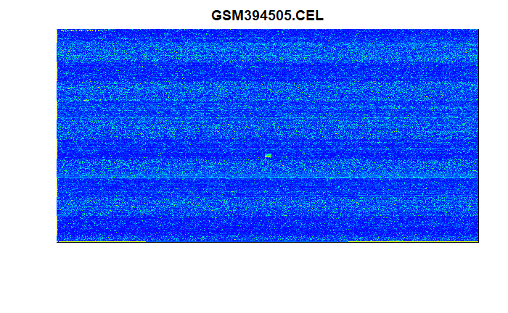
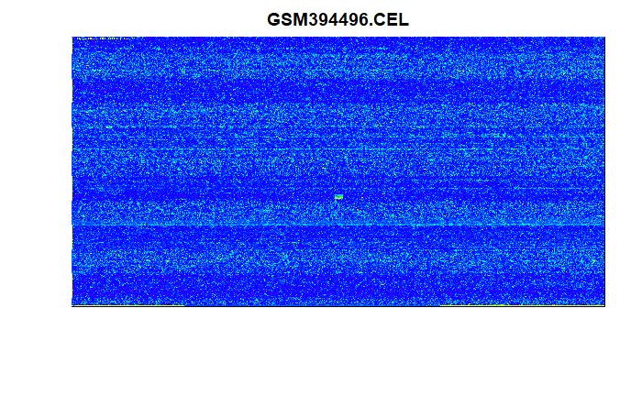
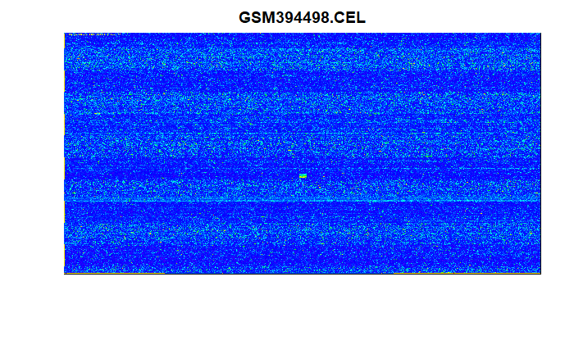
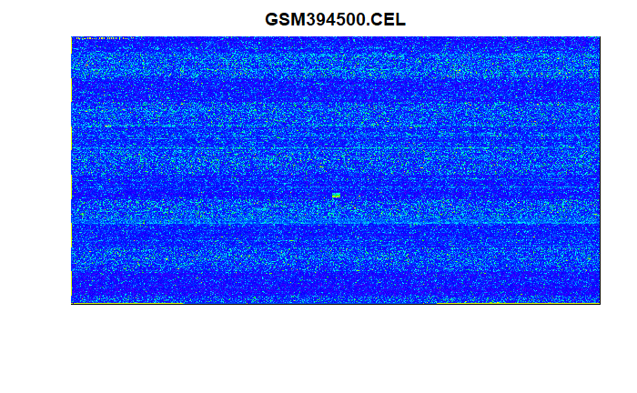
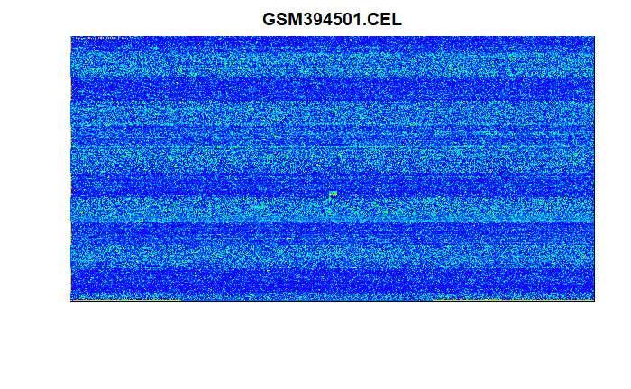



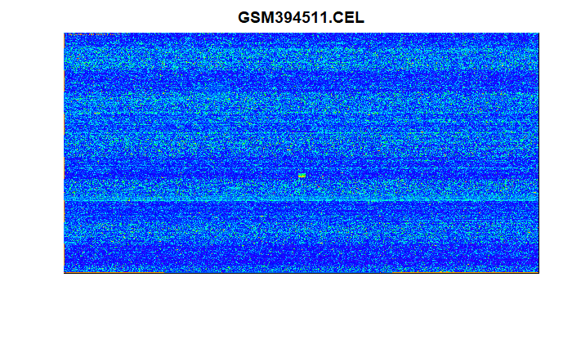
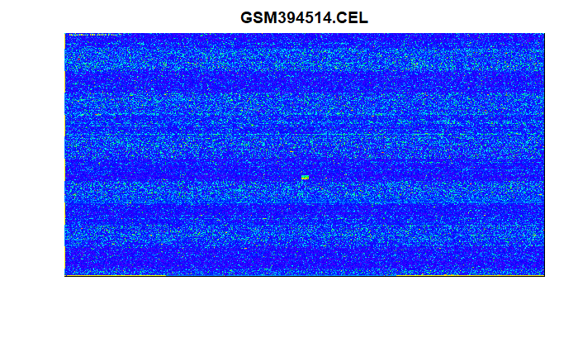
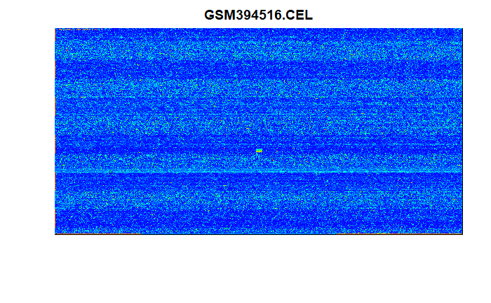
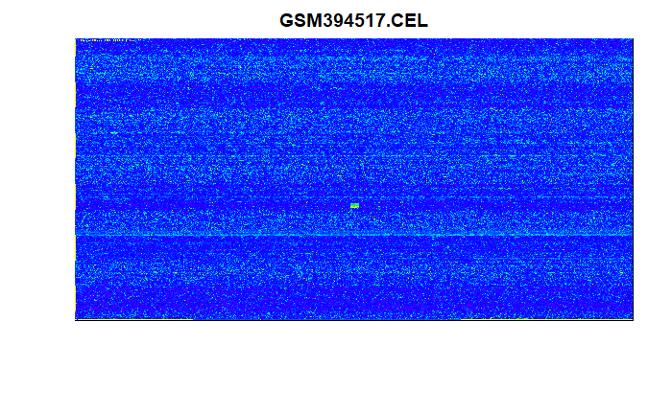
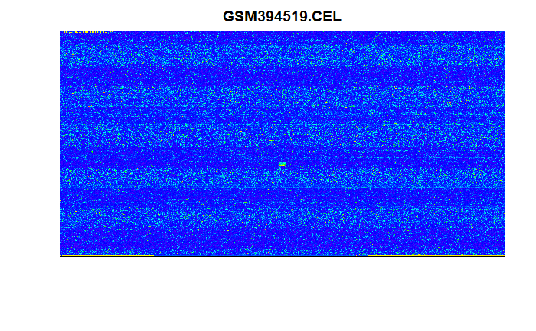

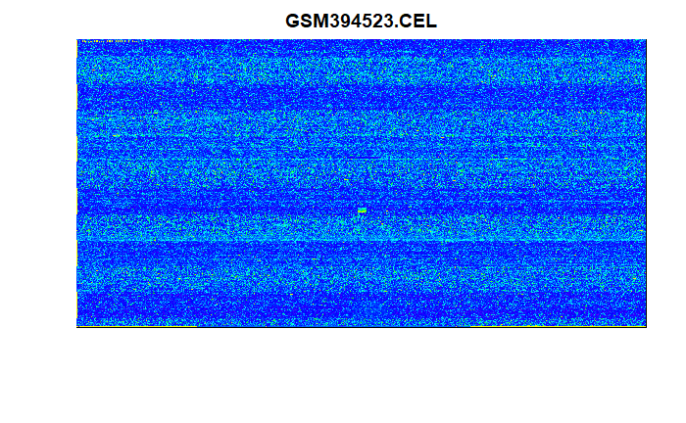
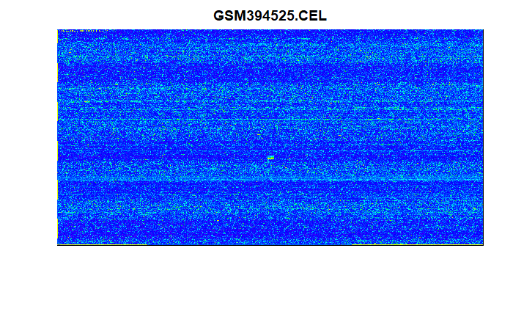


1. Array surface images (QC)
No spatial artefacts, fingerprints, irregular dye or stripes
slight differences in overall expression detection
Notes:
Starting with the Quality control, we can first observe the surface images of the array. On the 18 chips we can see no spatial artefacts, no fingerprints, no irregular dye or stripes. We can detect slight differences in overall expression detection though, for example if we compare Microarray 12 with 17. This however is still in its boundarys and should be corrected after our normalization.

Slide 9
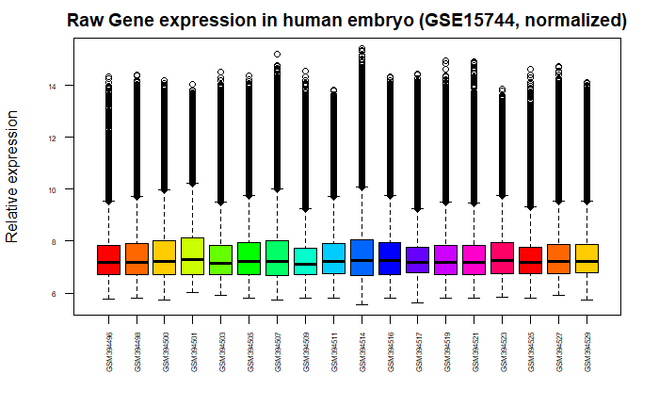
2. Expression boxplot vsnrma normalized (QC)
All chips in similar range after normalization
All 18 chips accepted
Notes:
Next up we got our boxplots which confirm that we can normalize our data by variance stabilization and the robust multichip average. These deal with systematic errors and random fluctuation and give us comparable results. These boxplots show us, that we do not need to eliminate an unfitting chip.

Slide 10
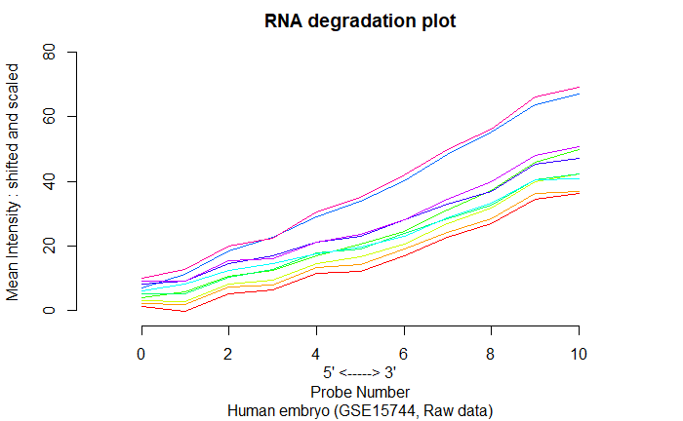
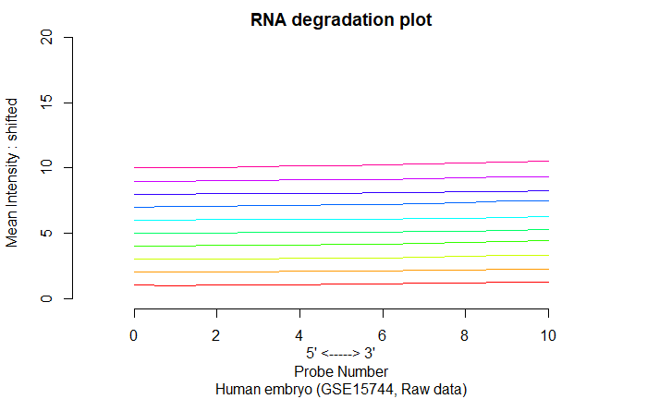
Quality control
3. RNA degradation plots
Similar distribution in RNA degradation in all chips
All 18 chips accepted
Notes:
Next up we got our RNA degradation. The RNA bound to the surface and is an unstable molecule that degradates. This is no problem for statistics as long as the degradation happens at the same time on each microarray.

Slide 11
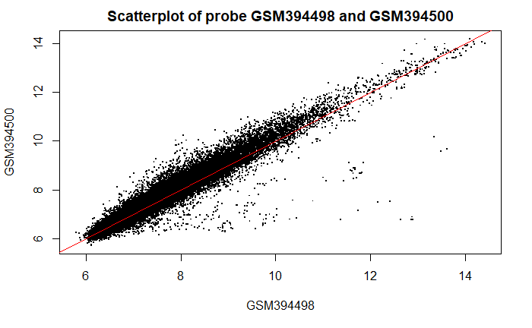
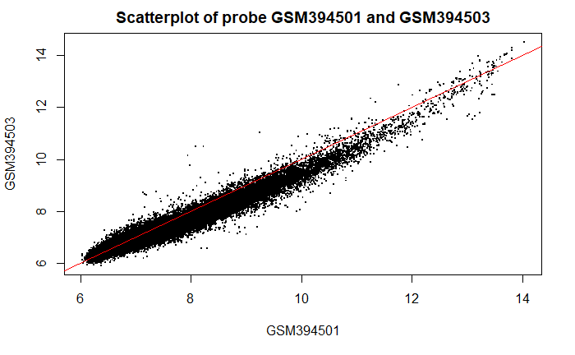
Quality control
4. Scatterplots
Similar distribution in RNA degradation in all chips
All 18 chips accepted
week 1, rep 2 and rep3
week 5, rep 1 and rep2

Slide 12

Timeline
Further Analysis
Screen for expression patterns using PCA and k-means clustering
Optional: explore chemokines
New Questions
Follow our research curiosity and explore new questions
Phase 1
31.05
Phase 3
28.06
Phase 5
19.07
Phase 2
14.06
Phase 4
05.07
Differential Gene Expression
Use Limma Analysis and
T-tests to determine differentially expressed genes for further analysis
Evaluate Results
Evaluate found data and connect findings with biological background
Final Steps
Compile all relevant data into report and final presentation
Notes:
Now that we have taken an in depth look at what we have achieved so far, lets switch our perspective around and take a look at where we want to go and what we want to achieve in the next two month.
Starting from today until the 31st of this month we are in phase one of our project: Differential gene expression. We are going to implement methods such as limma analysis and t-tests to further explore our data set and determine differentially expressed genes that will be of interest to us.
In Phase two, we will further analyze these genes of interest. We will do that by screening them for expression patterns using Methods like principal component analysis and k-means clustering. Optionally, we will also start exploring chemokines if there will be enough time for it. This second phase will end on the 14th of July. In Phase three, until the 28th of July we will start with the in depth evaluation of our found data. We plan on connecting our findings with the biological background and doing more research based on our findings. Phase four will be used to explore any new questions and ideas that will come up during the process of our project. We wil use this time to follow our research curiosity and personal interests. This will be going on until the 5th of July. Phase five will be used to take all necessary steps to conclude this project. We will compile all relevant data into a report and prepare a final presentation. This will be used to present all our gained knowledge to you. This last Phase will end on the 19th of July, just one day before we will conclude this project by holding our final presentation.

Slide 13
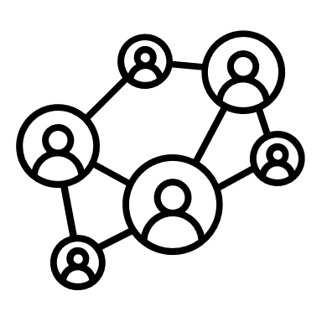
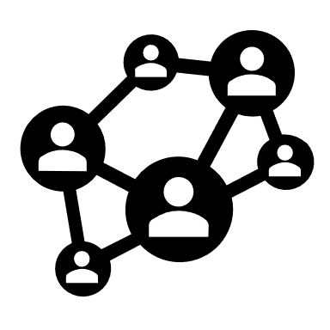









Building Blocks of our Teamwork
Staying connected
WhatsApp as main tool of communication
Tracking Progress
Log each meeting via Google Docs to keep overview of to-dos and topics
Tutorial Debriefing
Asses tutorial and collect immediate thoughts
Round Table
Tuesday 5 pm, in-depth discussion of tutorial and setting this week's tasks
Keeping it flexible
Remote meetings via Discord when needed
Notes:
Now that we have discussed what we want to achieve, it is also important to take a look at how we want to achieve that. To make this whole project a success, we have defined five building blocks for our teamwork. These are all aspects that we deem necessary for achieving our goals and succeeding as a team.
Fist and foremost: staying connected. Good Communication is key when it comes to teamwork, so we have chosen WhatsApp as our main tool of communication as it allows us to share information fast and easy. Second, we have decided on tracking our progress toroughly, so that we always have a clear overview of what we have already achieved and what still needs to be done. For the purpose of this, each team meeting is logged in a protocoll via google docs. This includes an in depth to-do list with tasks assigned to a specific person that will be checked upon the beginning of the next meeting.
Next, we have out tutorial debriefing. After every tutorial with you Ian, we meet up as a group to assess how productive the tutorial was. We also collect our imideate thoughts and ideas and any new insight that we gained. Now to one of the most important aspekts. The round table. Every Tuesday evening at five pm we meet at a conference room in the library and hold our weeks main meeting. This includes an in-depth discussion of our tutorial with Ian earlier in the day and exploring of our further developed ideas from the tutorial debriefing. We also recap what we achieved in the last week and distribute tasks for the coming week.
And last but definitely not least: keeping it flexible. There can always be unforeseen circumstances and unexpected problems that need immediate discussion. For instances as such we use discord as a tool to hold remote meetings so we can solve situations like that as fast as possible and move on from them.

Slide 14
Biological background
1. Biological thesis
How do TRAs influence embryonic development ?
Do TRAs influence the development of the CNS during week 4 to 9 ?
Are chemokines or their receptors presented in this developmental stage ?
Notes:
TRAs are meant to play an important role in embryogenesis, therefor we’ll investigate: How do TRAs influence embryonic development ?
Furthermore we’ll try to figure out, if TRAs influence the development of CNS during week 4 to 9. In addition we’ll try to identify the role of chemokines for the CNS in this period.

Slide 15
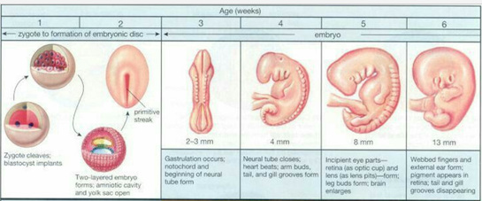
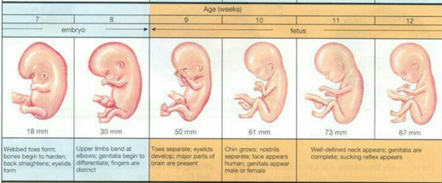
Biological background- Supplementary
1. Embryonic development
https://www.pinterest.de/supermamame/fetus-week-by-week/

Slide 16
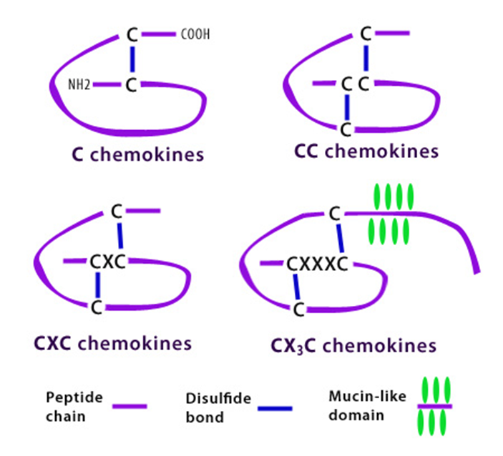
Biological background- Supplementary
2. Classes of chemokines
https://www.biolegend.com/chemokine_receptors

